Slide 1
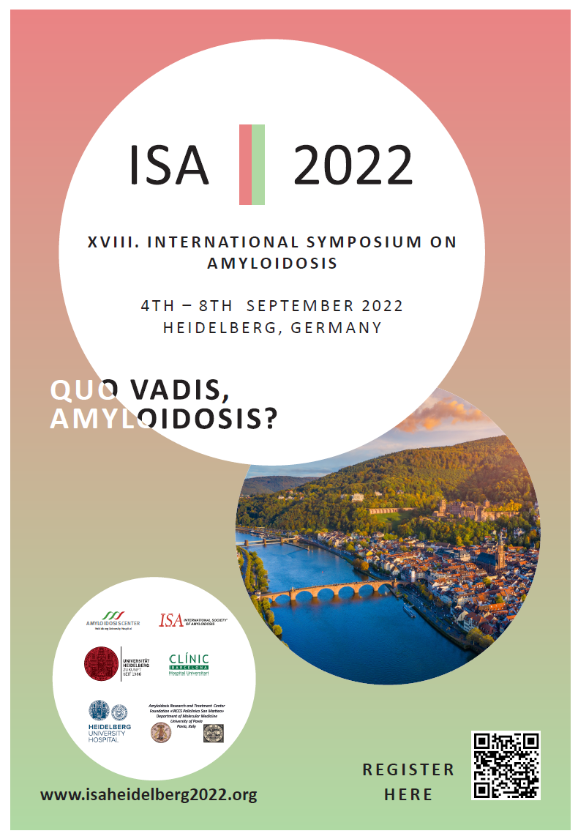
XVIII International Symposium on Amyloidosis
Heidelberg, Germany
4th - 8th September 2022
www.isaheidelberg2022.org
Registration starts
February, 15th 2022

